Slide 1
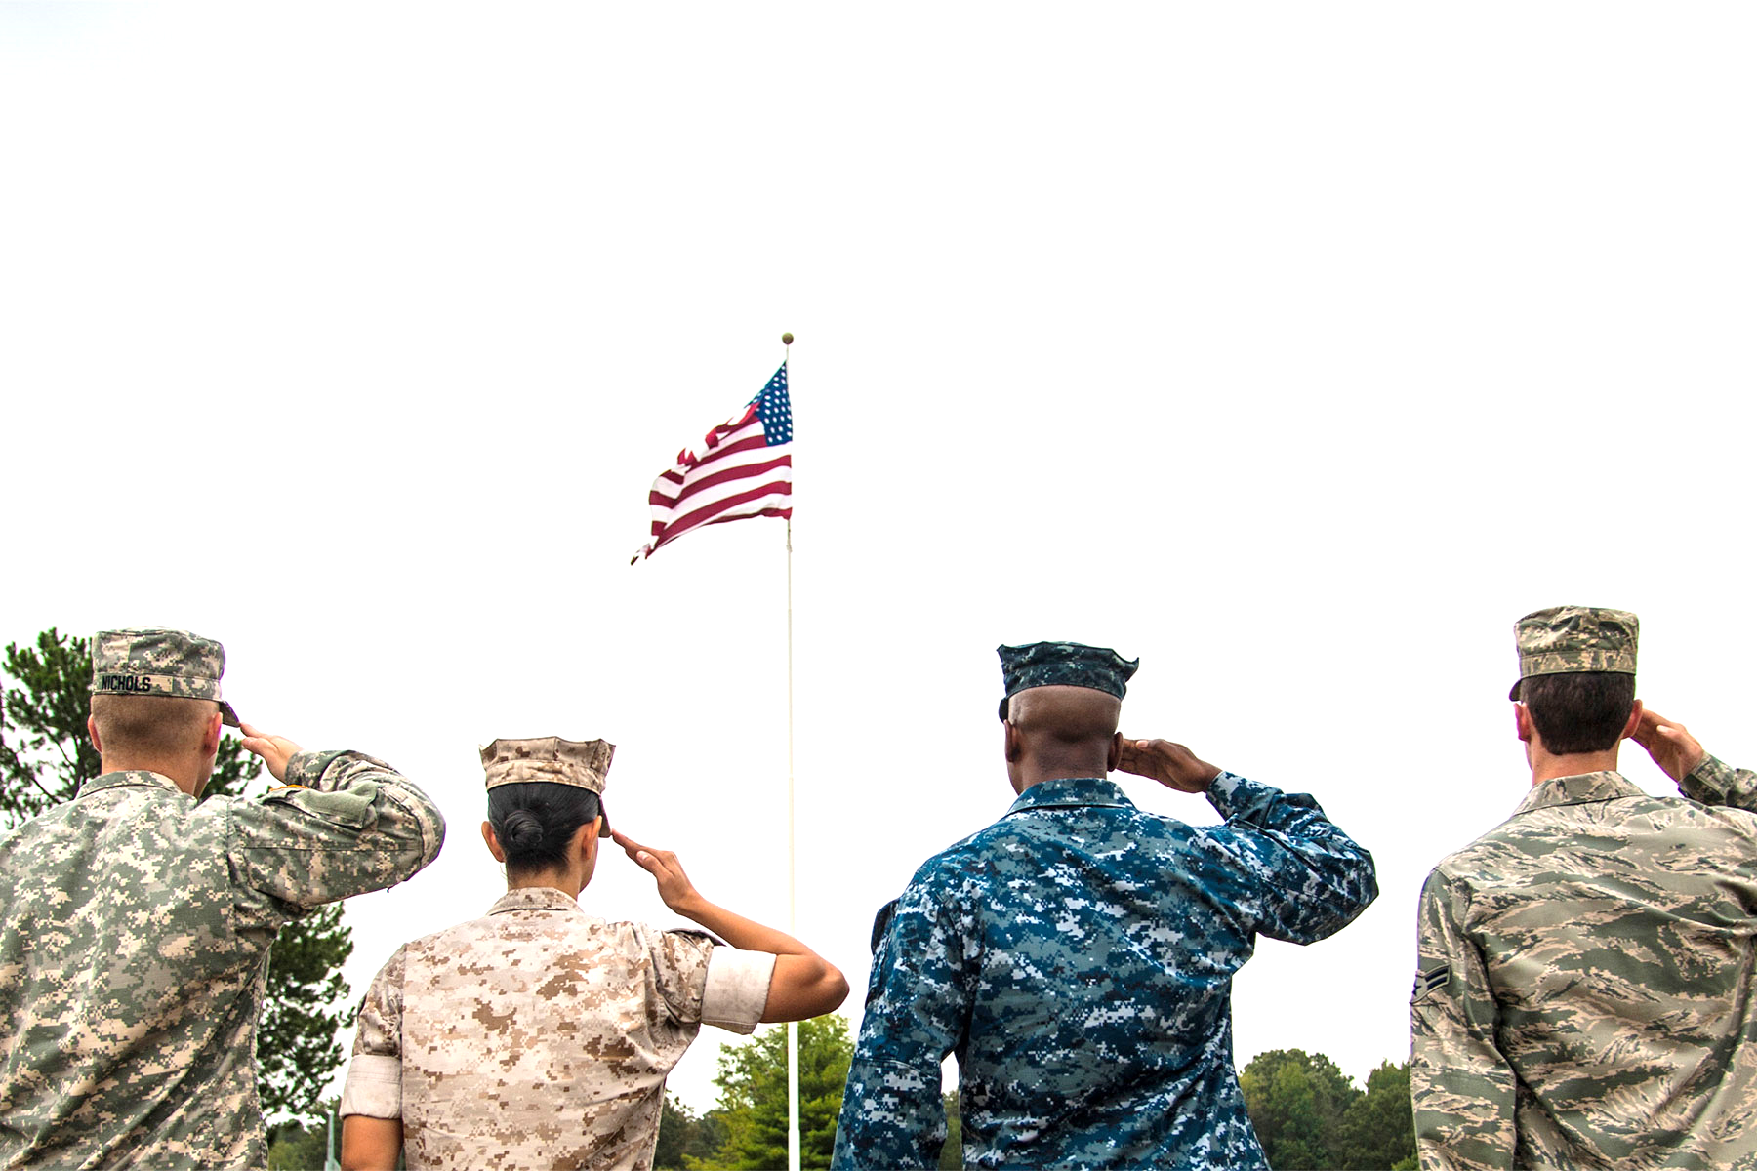
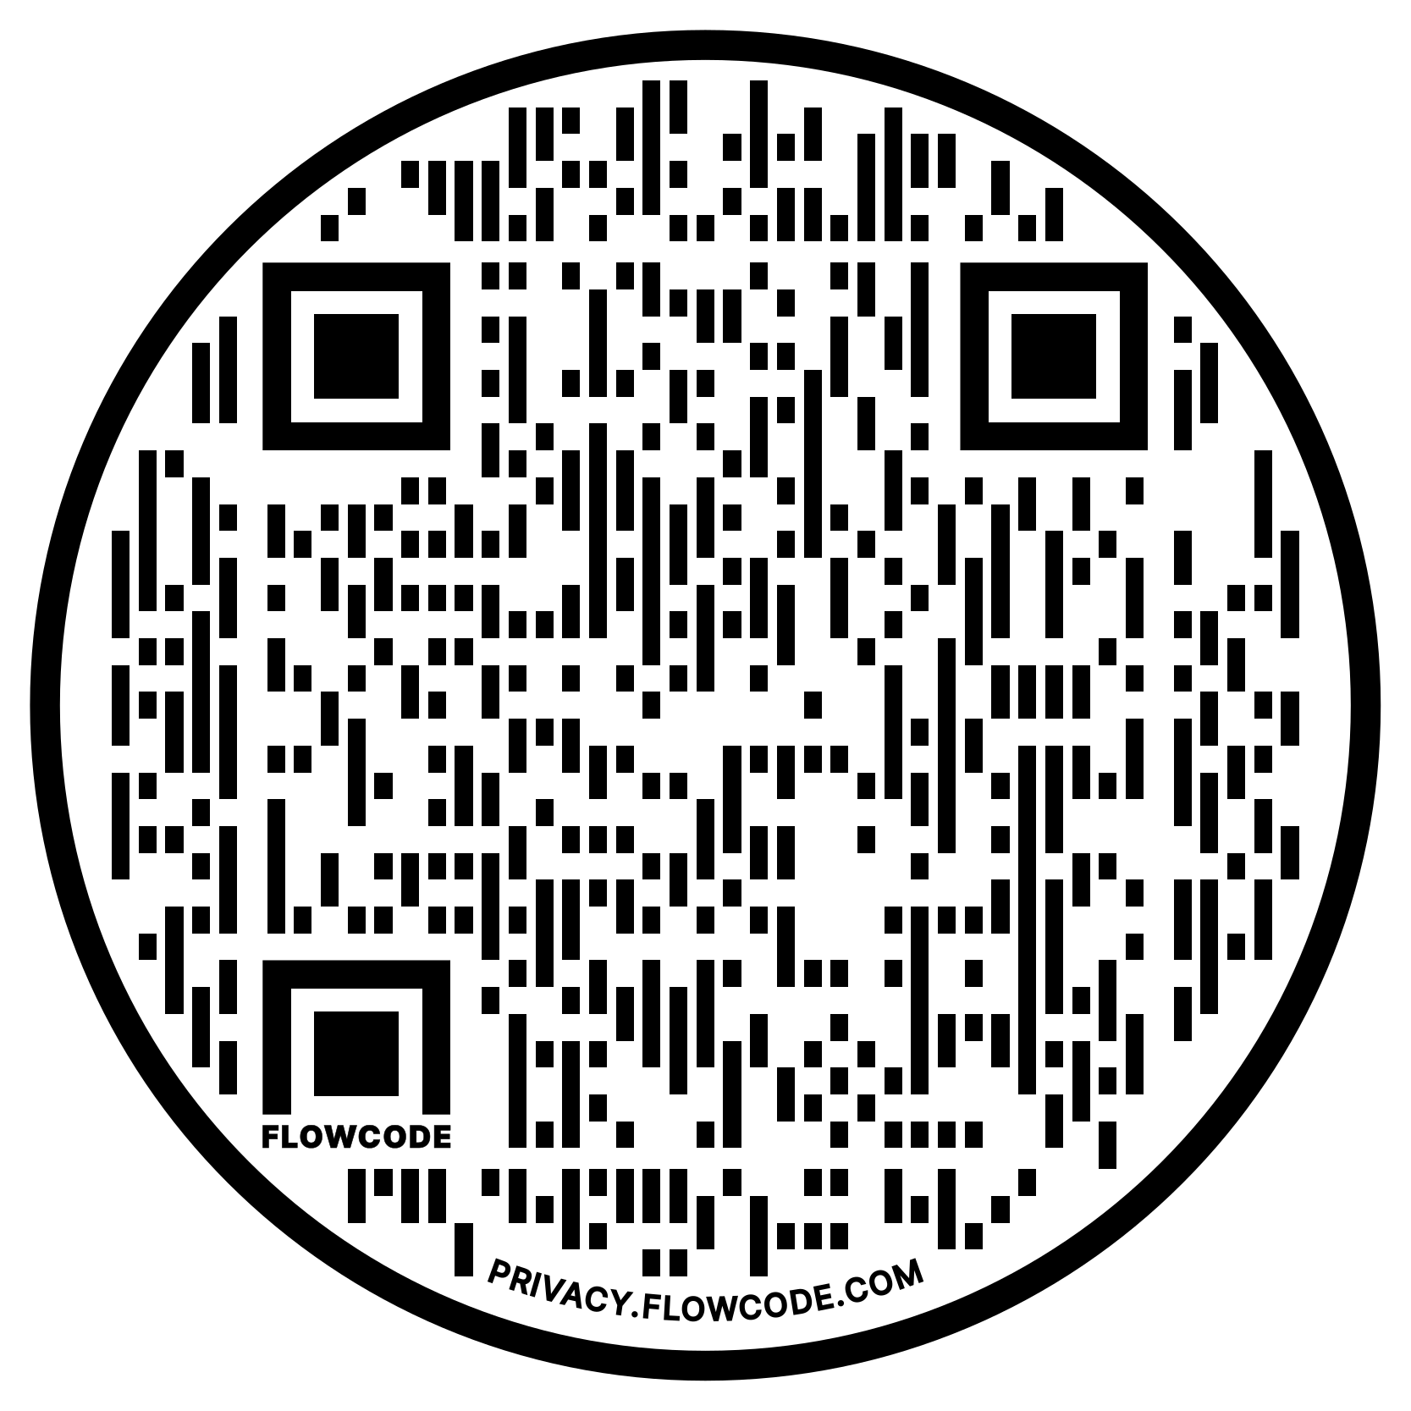
The Largest Veteran Event in the Tri-State Area
ATTENTION VETERANS
2022 - Veterans Bonanza!
Saturday, November 5, 2022, from 10:00 a.m. – 4:00 p.m.
If you are a Veteran, have a family member or have a friend
who is a Veteran, mark your calendar!
Services Available:
 Healthcare (Mental, Counseling, In-Home)  Dental  Nursing Care  Financial Advice  VA Claims
 Retirement Planning  End of Life Planning  Military Records  Employment  Recreation  Housing Assistance
and much more!
November 5, 2022
10 a.m. to 4 p.m.
The La Crosse Center
300 Harborview Plaza
La Crosse, WI 54601
For more information:
Website: VeteransBonanzaLAX.com
Facebook: VeteransBonanza/
Or call the La Crosse County Veterans Service Office at 608-785-9719

