Slide 1
Corporate Overview

Slide 2
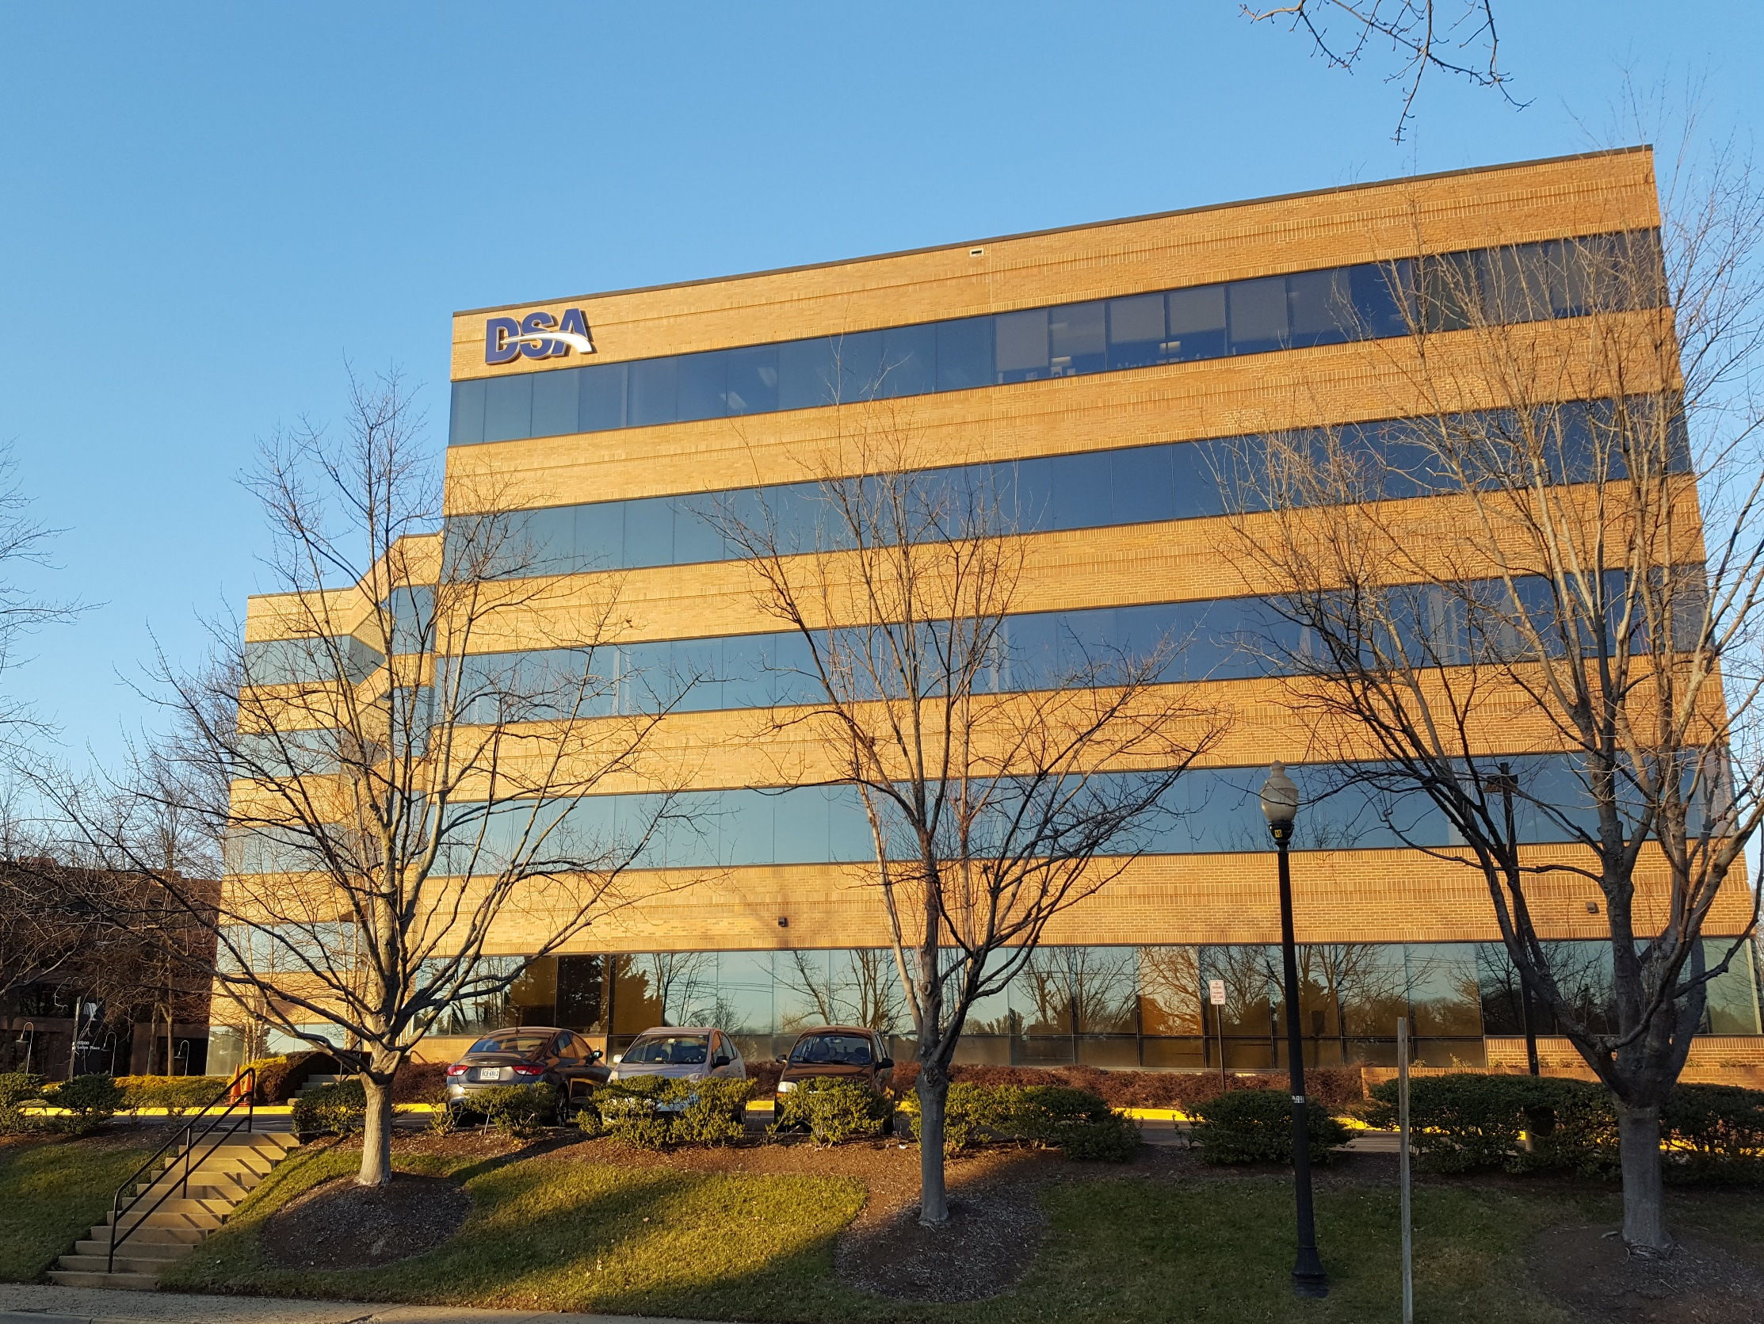
Founded in 1963, Data Systems Analysts, Inc. (DSA) has been providing Defense and Federal Government customers business-driven Information Technology and consulting solutions and services for more than 55 years. DSA's people excel in helping our customers achieve sensitive, mission-critical business goals and objectives.
DSA is a 100 percent employee-owned company: every employee has a stake in the success of our company and our customers. Corporate locations listed below. Operational in 23 States at Customer work sites.
DSA Headquarters
8 Neshaminy Interplex Suite 209
Feasterville-Trevose, PA 19053
DSA Aberdeen MD
210 Research Boulevard
Suite 250
Aberdeen, MD 21001
DSA Fairfax VA
10300 Eaton Place
Suite 500
Fairfax, VA 22030

Slide 3
Our Focus
DSA has deep expertise and comprehensive understanding of the operational, security, collaboration, and cybersecurity challenges that our customers must address to achieve sensitive, mission-critical goals and objectives. We have employees supporting customers in 59 locations in 23 states, the District of Columbia and Camp Smith Hawaii.
DSA is a mature, mid-size business with proven and certified business processes and longevity within our industry.
DSA offers all employees a Comprehensive Employment Package including 20% match to our 401K Plan, Employee Stock Ownership, Tuition Discounts, Tuition Assistance, Medical, Dental, Vision, Disability Insurance, Life Insurance, 100% Paid Technical Training, Employee Assistance Plan, Monthly Incentive Awards, Vacation and Sick Leave, Pet Insurance, Identity Theft Protection, and various Voluntary Insurances.
We will always deliver on our promises!
- Fran Pierce, CEO

Slide 4
Corporate History
Data Analytics
Across six decades, DSA has supported
the Nation’s Warfighters and their Missions
Software Services
Cloud
Services
Critical Infrastructure Intelligence Systems
‘60s
‘80s
‘00s
‘70s
‘90s
‘10s
1963 DSA Founded 1964 Develops OCONUS AUTODIN solution for DCA 1975 Supports C2 messaging in theaters intelligence and C3 Integration 1982 Supports transition of MILNET (DDN) from AUTODIN II 1988 Supports AUTODIN Modernization Project 1993 Supports completion of full mission capability of AUTODIN-DMS Transition Project 1994 DISA selects DSA to provide DMS test and program management services 1996 DSA develops first enterprise security solution for new DISN network 1998 PEO C3T selects DSA for KM Task; DSA begins Acquisition Center Support 2001 DSA personnel deploy to Kuwait and Iraq to support OIF C2 Mission 2003 Begins engineering support for intelligence customers 2005 Supports Army PEO C3T's Hurricane Katrina response mission 2007 Deploys JPEO-CBD KC 2008 Awarded DISA ENCORE II prime IDIQ Contract 2009 Implements social networking for Armed Forces; Awarded E2 Task Order in support of Army PEO AMMO 2012 Supports one of the largest SharePoint instances in the Army 2013 Awarded major E2 Task Order in support of Army ARDEC 2014 Awarded GSA OASIS IDIQ; DITCO ranks DSA 4th of 26 ENCORE II primes in Total Contract Value 2015 Awarded CS-TAT IDIQ; awarded contract to support US Navy Facilities Command; acquires Symbolic 2016 DISA ranks DSA 3rd of 26 ENCORE II primes in Total Contract Value Awarded, awarded multiple contracts in support of National Ground Intelligence Center 2017 DSA acquires Project Performance Company (PPC), LLC; Awarded $37.4B Army Responsive Strategic Sourcing for Services (RS3) IDIQ Contract 2018 Awarded $50B Alliant 2 IDIQ Contract; Awarded $12.1B Army ITES-3S IDIQ Contract; Awarded $28B IAC MAC IDIQ; DISA ranks DSA 2d of 26 ENCORE II primes in Total Contract Value Awarded; Awarded JE OPETS Engineering and Technology, and Information Technology (BEI) MAC IDIQ 2019 Awarded three JPEO-CBRND prime contracts
DSA has supported the Defense Messaging System (DMS) without interruption since 1963

Slide 5
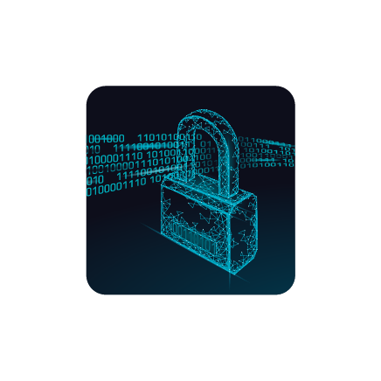
Our Core Competencies
Intelligent Analytics
Digital Modernization
Cyber Security
Cloud

Slide 6
Our Customers

Slide 7
Industry Partners

Slide 8
Example Products Supported
Enterprise Linux

Slide 9
Cloud
Systems and application design, migration, optimization and transformation within commercial and on premise cloud infrastructure.
Key Capabilities & Customers’
Performance Results

Slide 10
Cloud
Key Capabilities & Customers
• Cloud Based Systems and Application Design
• Systems and Application Migration
• Provisioning Service Engineering Support
• Cloud Account Provisioning
• Cloud Systems Accreditation
Current and Recent Customers
Department of Defense
Army Acquisition Community including ASA(ALT) HQ, CERDEC, PEO EIS, PEO CS&CSS, PEO IEW&S, PEO Soldier and SoSE&I
National Ground Intelligence Center (NGIC)
Department of Homeland Security (DHS)
National Archives and Records Administration (NARA)
Department of Justice (DOJ)
Delivered first ever SaaS solution for DHS ICE
in the AWS GovCloud

Slide 11
Cloud
Federal and Commercial Performance Results
National Archives and Records Administration
Department of Justice
Department of Homeland Security
DSA supports NARA’s Description & Authority System (DAS), the primary card catalog for the National Archives and Records Administration. NARA’s National Archives Catalog (NAC) is an online public portal with access to records. The catalog also searches all webpages on Archives.gov.
Support Includes:
Supporting DAS, NARA’s first enterprise application in the cloud
Migrated the DOJ Victim Notification System platform and communication systems from the Rockville, MD Data Center and Appriss Louisville Data Center to the AWS cloud.
Support Includes:
Detailed Cloud Inventory
Cloud Shaping Workshop and Design
Security Control Impact Assessment
Migration Certification
Delivered first ever SaaS solution for the DHS ICE VINE system in the AWS GovCloud that complies with significant and complex security requirements.
Support Includes:
Integrated security monitoring
Cloud Service Router management
Integrated security management with DHS OneNet

Slide 12
Cloud
DoD Performance Results
National Ground Intelligence Center
PEO EIS MilTech Solutions
Air Education & Training Command
DSA provides Army Military Intelligence (MI) Community Information (CI) Technology Enterprise (ITE) Cloud Support to NGIC.
Support Includes:
Providing Cloud Account and Service Provisioning.
Cloud governance and business process support.
RMF for Cloud Services.
Software re-factor/re-host migration evaluation, planning assistance and execution.
Developed, implemented and provisioned the Army’s C2S reference architecture (designed to bring together the 200+ current instances of cloud like systems in the Army into singular architecture, using infrastructure and platform as a service). Deployed on two networks (Unclassified and Classified).
Provided a foundation from which Army Military Intelligence (MI) applications can reach RMF authorization in a more efficient manner taking advantage of cloud technology and automation by enhancing overall security posture and governance.
DSA provides MilTech Solutions and its DoD customers with Cloud services to include: Providing Cloud Account and Service Provisioning; RMF for Cloud Services; Software modernization and optimization services; and Cloud migration services evaluation, planning assistance and execution.
Support Includes:
Completed Cloud Service Provider (CSP) migration planning for milSuite.
Completed application optimization for transition to milCloud infrastructure.
Completed cloud governance strategy for milSuite.
Integrated ePolicy Orchestrator (ePO) Server and Assured Compliance Assessment Solution (ACAS) scans.
Built DISA milCloud Production and COOP environments for milSuite.
DSA provides AETC with Cloud services including: Software modernization and optimization services; Cloud governance and business process support; and Cloud migration planning assistance and execution.
Support Includes:
Built a Microsoft Azure Cloud environment to support AETC GTIMS development and testing requirements.
Built a Microsoft Azure Cloud instance to support the TIMS development and testing for current software production and maintenance.

Slide 13
Intelligent
Analytics
Extract hidden knowledge, deliver breakthrough insights and drive more informed decision making.
Key Capabilities & Customers’
Performance Results

Slide 14
Intelligent Analytics
Key Capabilities & Customers
• Enterprise Architecture and Design
• Critical Infrastructure Intelligence Systems
• Data Modeling and Integration
• Data Mining
• Data Warehousing
• Data Visualization, Reporting and Dashboard Design
• Enterprise Information Management
• Predictive Analytics
Current and Past Customers
Department of Defense
Army Acquisition Community including ASA(ALT) HQ, CERDEC, PEO EIS, PEO CS&CSS, PEO IEW&S, PEO Soldier and SoSE&I
National Ground Intelligence Center (NGIC)
Army Contracting Command (ACC)
Joint Program Executive Office for Chemical, Biological, Radiological, Nuclear Defense (JPEO-CBRND)
Naval Facilities Command (NAVFAC)
Department of Justice (DOJ)
Department of Energy (DOE)
Department of Agriculture (USDA)
Environmental Protection Agency (EPA)
US Patent and Trademark Office (USPTO)
Nuclear Regulatory Commission (NRC)
Commonwealth of Virginia
National Archives and Records Administration (NARA)
Transportation Research Board (TRB)
State of Maryland
National Nuclear Security Administration (NNSA)
Sandia National Laboratories
Office of Management & Budget (OMB)

Slide 15
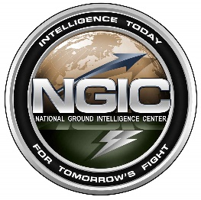
Intelligent Analytics
DoD Performance Results
Virtual Contracting Environment
PEO EIS MilTech Solutions
National Ground Intelligence Center
Navy Facilities Command Georeadiness Center (GRC)
Developed the Virtual Contracting Enterprise – Business Intelligence (VCE-BI) tools for the Army acquisition community supporting 8,500 users, 200 contracting organizations, and 50 Army Customers worldwide.
Support Includes:
BI solutions with oversight of over $80 billion in annual transactions.
Developed and re-engineered over 2,500 reports and 75 dashboards.
DSA, a QLIK partner, transitioned the Army user communities to the new Qlik Sense® platform.
Developed program-specific user guides embedded in the BI web platform and used Defense Collaboration Services (DCS) to train the geographically dispersed BI SMEs.
Supported BI initiatives for the US Army Program Executive Office Enterprise Information Systems Military Technical Solutions Office (MilTech), including nine major Army and Joint organizations for over 10 years.
Support Includes:
Implemented SAP Business Objects solutions for seven customers.
Designed, developed and currently maintain 400+ reports/dashboards.
Implemented Data Warehouse leveraging Data Integrator, ETL tools, and reports/dashboards.
DSA provided NGIC with Data Analytics support including Predictive Analytics on the Biometric Identity Intelligence Resource (Bi2R) System.
Support Includes:
Predictive Threat Probability Solution
Creation of senior leadership planning and execution dashboards, metrics, charts, statistics, analytics and graphs for high level reporting.
Data analysis, quality evaluation and normalization.
DSA provides full Geographical Information Systems (GIS) and information technology support including requirements definition, reporting and data collection of GRC enterprise data.
Support Includes:
Support the Georeadiness Explorer (GRX) which combines spatial data with tabular information to support Navy decision making.
Utilize COTS solution GIS software Environmental Systems Research Institute (ESRI) for Technological analysis at the Navy installation level with a focus on Financial Improvement and Audit Readiness (FIAR).

Slide 16
Intelligent Analytics
Federal and Commercial Performance Results
Restored Utility
Operational Data Collection
Business Intelligence & Enterprise Reporting (BIER)
Office of Management and Budget
Neutron Generator Program
DSA deployed the OSIsoft PI platform in support of the University of Maryland Facilities Management organization.
Support Includes:
DSA designed a new, scalable, onsite, centralized Operational Data Warehouse (ODW) that delivers improved situational awareness through intuitive alerts and notifications with ability to analyze root causes of the incidents.
Improving operations:
Improved response times
Over $1M in savings
Predictive maintenance
Integrated incident management
DSA supported the Business Intelligence and Enterprise Reporting (BIER) strategic initiative for the US Marshals Service.
Support Includes:
Provided comprehensive enterprise reporting, data manipulation, and data validation tools where end users can build and generate custom reports on demand using established data universes.
DSA provided Business Intelligence support to the U.S. Office of Management and Budget (OMB) in support of the MAX.gov community site for federal data collection and collaboration.
Support Includes:
Provided centralized data collection, management, analytics tools to analyze, visualize, and distribute data on federal budget reporting.
DSA is designing a operational intelligence system for Sandia National Labs to collect and monitor process data related to the manufacturing of Neutron Generators.
Support Includes:
20 Process Areas
500 Unique Data Points
Critical Alerts and Notifications

Slide 17
Digital
modernization
Migration and Modernization of Legacy Business Processes, Systems, Applications and Infrastructure to efficient Cloud-based, Low-Code solutions for improved security and O&M costs.
Key Capabilities & Customers’
Performance Results

Slide 18
Digital Modernization
Key Capabilities & Customers
• System Architecture, Design, and Requirements Analysis
• Infrastructure Optimization Services
• Comprehensive Cloud Realization
• Application Development
• Modernization assessments including cost savings and Analysis of Alternatives (AoAs)
• Business Process Reengineering
Current & Recent Customers
Department of Defense
Army Acquisition Community including ASA(ALT) HQ, CERDEC, PEO EIS, PEO CS&CSS, PEO IEW&S, PEO Soldier and SoSE&I
National Ground Intelligence Center (NGIC)
Joint Program Executive Office for Chemical, Biological, Radiological, Nuclear Defense (JPEO-CBRND)
Army Contracting Command (ACC)
Air Force Air Education & Training Command (AETC) Advanced Distributed Learning System
DISA National Gateway Center (NGC)
National Archives and Records Administration (NARA)
Environmental Protection Agency (EPA)
US Patent and Trademark Office (USPTO)
Department of Justice (DOJ)
Department of Energy (DOE)
Commonwealth of Virginia
State of Maryland
National Park Services (NPS)

Slide 19
Digital Modernization
DoD Performance Results
Virtual Contracting Environment
PEO EIS MilTech Solutions
AETC Advanced Distributed Learning System
DISA National Gateway Center
DSA developed the Virtual Contracting Enterprise (VCE) tools for the Army acquisition community, that provide Program Management, Systems Engineering, Software Development, Training, Solution Deployment and Help Desk Operations and Support.
Support Includes:
15,000 end-users in more than 250 CONUS/OCONUS contracting locations.
Replaced outdated legacy systems and processes with enterprise applications resulting in contract cost savings of more than $40M annually.
BI solutions for the ARMY Contracting Command ACC with oversight of over $80 billion in annual transactions.
DSA supports PEOEIS MilTech Solutions digital modernization efforts for applications, systems and infrastructure that supports eight Army Program Executive Offices.
Support Includes:
Provided system modernization on systems supporting over 1M CONUS and OCONUS users on multiple DoD networks.
Virtualized infrastructure and optimized legacy applications
Provided business process reengineering to apply Better Buying DoD approach to JPEO-CBRND.
DSA supports the production and sustainment of the Advanced Distributed Learning Service (ADLS) system and the next generation Web Learning Content Delivery System (WLCDS).
Support Includes:
Successfully led the redesign and modernization of AETC’s Advanced Distributed Learning System (ADLS).
DSA supports the NGC OMS messaging backbone comprised of systems and tools that fall under the operational sustainment and management control of DISA.
Support Includes:
Designed, developed and modernized DISA’s Message Conversion System (MCS) in support of Command and Control Messaging.

Slide 20
Digital Modernization
Federal and Commercial Performance Results
National Archives and
Records Administration
Department of Justice
National Park Service
Commonwealth
of Virginia
DSA provides NARA with systems modernization and cloud Implementation services.
Support Includes:
Enabling NARA to realize 80% annual Cost Savings through systems modernization using the Cloud.
300% increase in System Performance using Cloud solutions.
DSA employs advanced technologies to ensure continuous improvement and operational support of the Victim Notification Service (VNS), which processes over 1.1 million notifications every month for the 300+ active tracked Federal cases.
Support Includes:
DSA is modernizing the Victims Notification System (VNS) to implement a Low-Code, AWS Cloud solution
DSA modernizes all service wide activities related to the Cultural Resources Database.
Support Includes:
Support the protection and preservation of 33,000+ historic and prehistoric structures, 500+ cultural landscapes, and 70,000+ archeological sites.
DSA delivered Virginia’s
Award-Winning Performance Budgeting System.
“2014 Excellence in VA Government Award for Innovation in Government”

Slide 21
Cyber Security
A comprehensive Defense-in-Depth view of an organization’s security posture to mitigate risks and ensure compliance with relevant guidelines.
Key Capabilities & Customers’
Performance Results

Slide 22
Cyber Security
Key Capabilities & Customers
• Cyber Engineering and Architecture Design
• System Authorization Services
• Regulatory Review and Guidance
• Lifecycle Support of Security Technologies
• Risk Management and Threat Diagnosis & Analysis
• Assessment & Authorization
• Penetration Testing
Current and Recent Customers
Department of Defense
Army Acquisition Community including ASA(ALT) HQ, CERDEC, PEO EIS, PEO CS&CSS, PEO IEW&S, PEO Soldier and SoSE&I
National Ground Intelligence Center (NGIC)
CECOM Software Engineering Center (SEC)
Joint Program Executive Office for Chemical, Biological, Radiological, Nuclear Defense (JPEO-CBRND)
Deputy Chief of Naval Operations (DCNO)
DISA Business Enterprise Architecture (BEA)
DISA National Gateway Center (NGC)
DISA PEO Enterprise Services (ES)
US Pacific Command (USPACOM)
Air Force Air Education & Training Command (AETC)
Department of Energy (DOE)
Sandia National Laboratories
Nuclear Regulatory Commission (NRC)
Department of Interior (DOI)
Environmental Protection Agency (EPA)
Commercial Nuclear Energy Provider
National Archives and Records Administration (NARA)
US Patent and Trademark Office (USPTO)
Los Angeles Metro
Other Commercial Clients

Slide 23
Cyber Security
DoD Performance Results
National Ground Intelligence Center
Joint PEO for Chemical, Biological, Radiological, Nuclear Defense (JPEO-CBRND)
Air Education & Training Command
DISA National Gateway Center
DSA support authorization and accreditation activities for critical systems deployed across various programs within NGIC. NGIC is currently the only INSCOM unit that is 100% ATO compliant.
Support Includes:
Completed 17 Certificate of Networthiness, 16 Product Description Documents and five signed ATOs
First INSCOM start to finish RMF ATO for stand-alone system and NIPRNET
Authored the first Overlay for stand-alone systems for DoD
Closed Network support including systems hardening
DSA provides Cyber support to identify and prevent cyber attacks for JPEO-CBRND and its customers’ mission critical systems.
Support Includes:
Assisted seven programs in completing self-assessments and attaining an IATT (Interim Authorization to Test).
Assisted more than 20 programs in creation and modification of their key Risk Management Framework documents on the path to ATOs.
Supported six Cooperative Vulnerability Penetration Assessment and Adversarial Assessment events.
Supported Authorization to Operate (ATO) Approval for two JPEO-CBRND programs with two additional ATOs awaiting approval.
DSA provides Risk Management Framework (RMF) and cybersecurity consulting to the AETC/A5.
Support Includes:
Assisted the AETC Cybersecurity Office with developing an Information Technology Infrastructure Library (ITIL) based Responsible, Accountable, Consulted, and Informed (RACI) matrix for Risk Management Framework (RMF) controls that help integrate activities throughout the organization.
Combined three flying training management systems into a single RMF package receiving an Authorization to Operate (ATO) and Authority to Connect (ATC).
DSA supports authorization and accreditation activities for the Organizational Messaging as a Service Program.
Support Includes:
Developed and obtained first authority to operate for the Defense Message System (DMS). Successfully implemented RMF in DISA’s Organizational Messaging Service (OMS) Program.
Earned outstanding or above on all DISA Cyber Command Readiness Inspections.
Ensured compliance of NGC systems with CYBERCOM IAVAs and DISA STIGs.

Slide 24
Cyber Security
Federal and Civilian Performance Results
Sandia National
Laboratories
Environmental
Protection Agency
Los Angeles Metro
Commercial Nuclear Power Company
DSA develops, maintains and operates high security systems that are essential to the Nation’s security. ISO 27001 and ISO 20000 certified services play a key role.
Support Includes:
Supporting multiple secure environments at Sandia, DSA assures the integrity, availability, and confidentiality of information.
DSA works with Sandia's business units to successfully enable Sandia to carry out new missions of critical national importance.
24/7/365 worldwide national security operations.
DSA supports the Senior Agency Information Security Officer (SAISO) with comprehensive information security services.
Support Includes:
Managing security compliance across EPA program offices and successfully completed:
60+ risk assessments across 25 task orders
70+ Security Assessment and Authorization (SA&A) packages and policy documents
DSA helped identify information security gaps within systems serving millions.
Support Includes:
DSA expertise supported the Los Angeles County Metropolitan Transportation Authority by conducting:
Cyber security analysis
External penetration assessments
DSA provides comprehensive critical infrastructure support in the energy sector.
Support Includes:
To modernize a situational awareness system, DSA security and energy experts are delivering a full spectrum approach to:
Assessment
Recommendation
Development
Implementation
Operation

Slide 25
Prime IDIQ Contract Vehicles
Prime Indefinite Delivery Indefinite Quantity (IDIQ) Contract Vehicles
DSA delivers services and products to Federal customers through a variety of prime contracts
Award Type | IDIQ Name | Award Type | IDIQ Name
L/U | GSA Alliant 2 | L/U | JPEO-CBRND JE OPETS Business & Analytical, Engineering & Technical, and Information Technology (BEI)
L/U | Army ITES-3S | L/U | JPEO-CBRND Joint Enterprise Research and Development Acquisition and Procurement (JE RDAP)
S/R & L/U | Army CECOM Responsive Strategic Sourcing for Services (RS3) | L/U | Navy Seaport-e (Large Business – All Seven Geographic Zones)
L/U | CIO-SP3 | S/R & L/U | ENCORE II
S/R | DoD Information Analysis Center Multiple Award Contract (IAC MAC) (Partial Small Business Set-Aside) | L/U | DoD C5 (Command, Control, and Communications in Cyberspace) Consortium
S/R | DoD Cyber Security and Information Systems Technical Area Task (CS-TAT) (Partial Small Business Set-Aside) | L/U | EPA ITS-BISS II
S/R | GSA OASIS Pool 4 | L/U | Virginia Next Generation Data Analytics
L/U | GSA IT Schedule 70 | L/U | Virginia Performance Budgeting IT Solutions
L/U | GSA Professional Services Schedule (Formally MOBIS)
Award Type: L/U is Large Business/Unrestricted || S/R is Small Business/Restricted

